Slide 1


Industry Project
Part II
Vardhan Kale, Abhishek Kanneganti, Sayema Hussain, Bhuwan Jain

Slide 2
Assignment Instructions
DELIVERABLES
Part-1 - Product Analytics
Part-2 - Growth Strategies
Part-3 - Product Roadmap
Part-4 - Product Backlog and Sprint Backlog
Part-5 - Product Requirements Document
Part-6 - Go-to-Market Strategy
SUBMISSION GUIDELINES
Part-1, 2 and 6 should be submitted in this PPT document.
Part-3 and 4 should be submitted in the excel document given on the platform.
Part- 5 should be submitted in the word document given on the platform.

Slide 3
Part 1
Product Analytics

Slide 4
Recap - AARRR Framework
Acquisition
Retention
Referral
A
A
R
R
R
Find the core
Concept
Activation
Revenue

Slide 5
Acquisition Metrics
Metric | Reason for choosing
Cost per Lead (CPL) | Money spent to identify potential customers
Customer Acquisition Cost | To measure cost of acquiring customers
Conversion rate in app store | To check the effectiveness of content in app store
Total # of new users per month | To measure success of marketing effort
Total users acquired by channel | To measure effectiveness of channel used.
Bounce Rate | To identify pain points for customers.

Slide 6
Activation Metrics
Metric | Reason for choosing
Monthly registration rate | To identify pain points during registration
Screens per session | To find the point of drop off.
Session length | To find if customers find UI / UX of app is engaging
# First bookings | To know how many customers visiting the app book
Search exit rate | To know if users are able to search for information
Feature adoption | Number of users who watched the product demo video

Slide 7
Retention Metrics
Metric | Reason for choosing
Churn rate | To know if business is loosing customer and understand the reasons. Is product complicated to use ? or is business targeting right audience ? Customer churn is important for staffing reasons as an employee can only manage so many accounts at one time.
N Day retention | Identify need for re-engagement Ads, Push Notification
Subscription Renewal rate | To know if customers subscribing to out weekly mean plan are renewing the subscription
Daily weekly monthly Active users | To measure how useful the app is to the user.
Cart abandonment rate | To know of any issue in online payment.

Slide 8
Revenue Metrics
Metric | Reason for choosing
ARPU , CLTV | Average revenue per user helps track growth patterns
Quarterly revenue churn rate. | Revenue churn is a great way to report on performance and understand the financial health of your customer base
LTV : CAC | if LTV : CAC > 3 , the business is considered to be healthy.

Slide 9
Referral Metrics
Metrics | Reason for Choosing
# of referrals | To get virality. Once click Sharing, Contact list integration
App store ratings and reviews | To know the need for updates to know new needs.
Viral Coefficient (K) | To know how many new users existing user generates and if we need to give incentives.
Net Promotor Score | To measure customer loyalty and therefore the likelihood of gaining new customers
Customer Experience Score (CES) | To measure ease of customer interaction and resolution during a request.
Customer Satisfaction Score (CSAT) | To measure users satisfaction with the product.

Slide 10
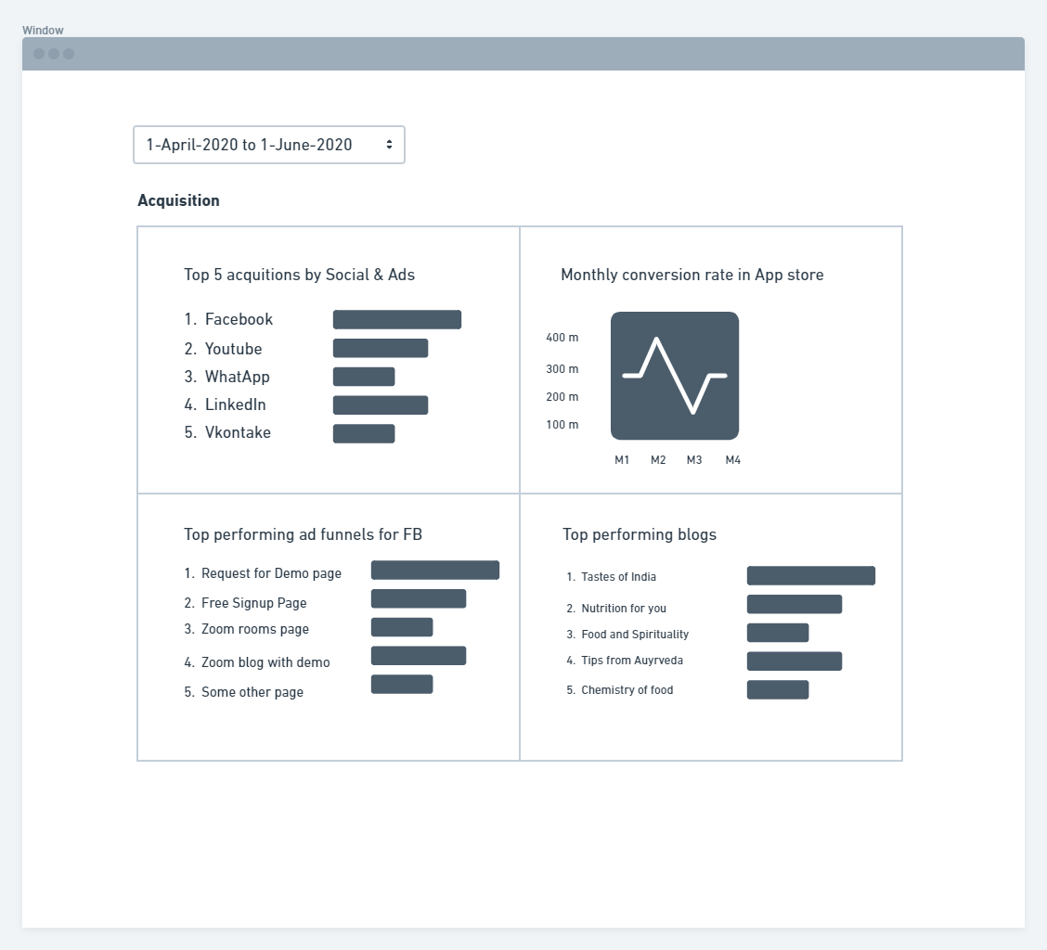
Wireframe - Analytics Dashboard
Acquisition Metrics
Top 5 acquision by Social Ads
Monthly conversion rate in App Store.
Top performing ad funnels for FB.
Top performing blogs.

Slide 11
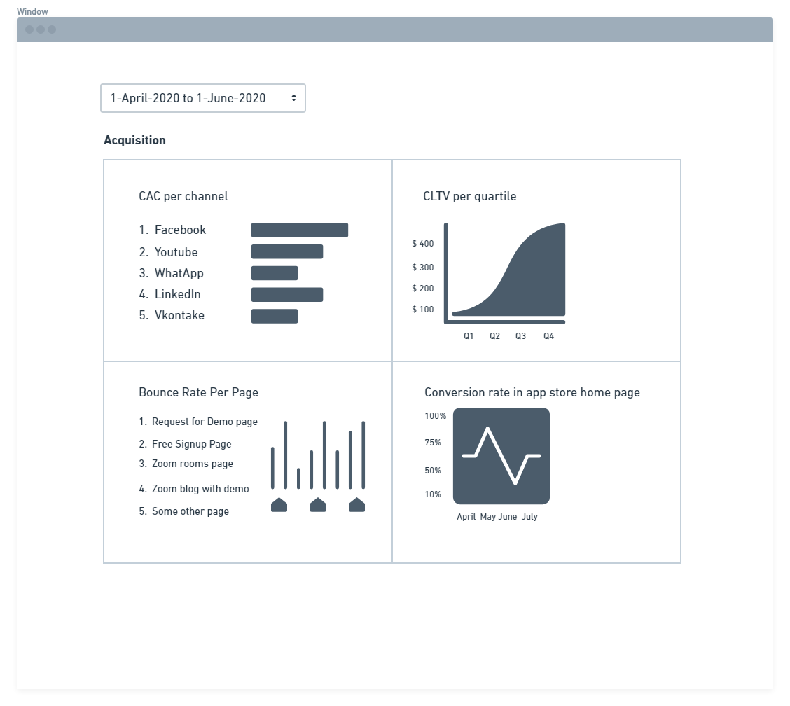
Wireframe - Analytics Dashboard
Acquisition Metrics
Customer acquision cost per channel
Conversion rate in app store.
Bounce rate per page.
Customer lifetime value per Quartile.

Slide 12
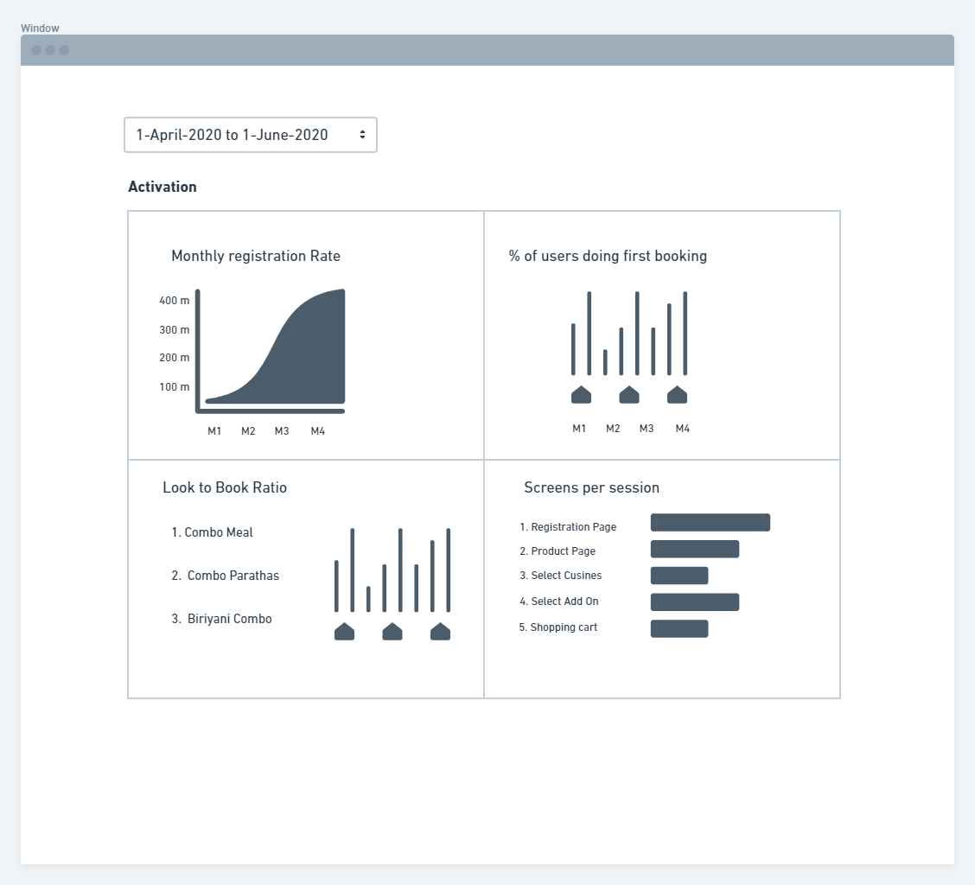
Wireframe - Analytics Dashboard
Activation Metrics
Monthly Registration Rate
%of users doing first booking
Look to book ratio
Screens per session

Slide 13
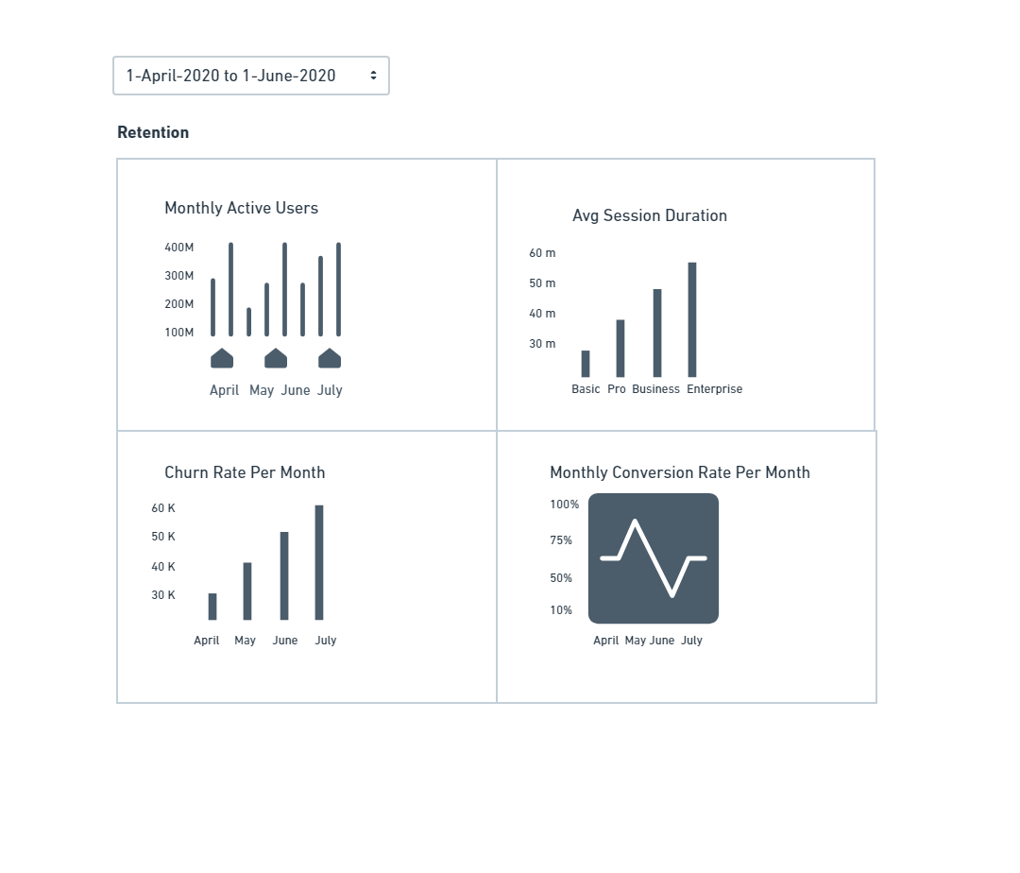
Wireframe - Analytics Dashboard
Retention Metrics
Monthly active users
Avg. session duration.
Churn rate per month.
Monthly conversion rate.

Slide 14
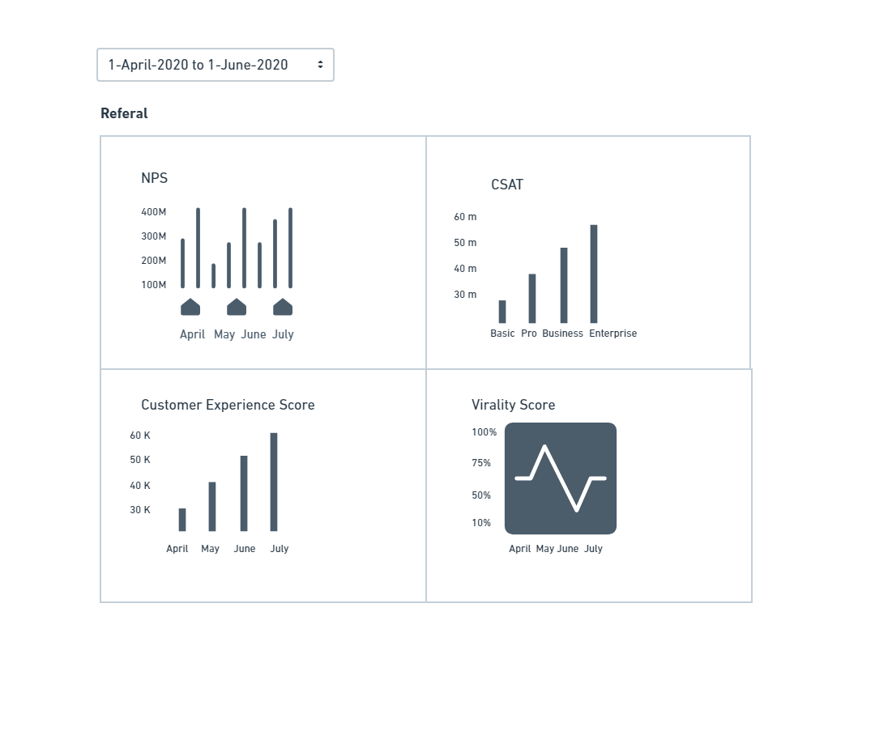
Wireframe - Analytics Dashboard
Referral Metrics
Net Promotor Score
Customer Satisfaction Score
Customer Experience Store
Virality Score

Slide 15
Part 2
Growth Strategies

Slide 16
Acquisition Strategy
Possible Tools to consider
https://www.clickfunnels.com
High level goals for Awareness & Acquisition
1. Informational
2. Welcome new subscribers
3. First Purchase
4. Refer a friend

Slide 17
Acquisition Strategy
Ways to Acquire | Channel Name | Customer Acquisition Journey | Strategy
Social Media Ads | Facebook, Instagram, YouTube, Google, WhatsApp | User journey when prospect DOES NOT becomes customer. Prospect clicks on social ads which leads to landing page. Prospect reviews beautiful content and reviews on page. Prospect leaves site without checking out. Prospect surf the web. Your ad recaptures their interest and brings them back. Customer opts in to receive SMS , WhatsApp updates. Customer receives a code and link to download mobile App. Customer downloads mobile app. | Retarget using Google AdWords Customer wants to know your brand. Goal is brand awareness. Hard sell is wrong at this stage.
News, Reviews, Media Coverage | Paid blogs, Influencers, News agencies | Customer reads a blog, news about offering and clicks link inserted for customer targeting. Leverage online sales funnel tools like https://www.clickfunnels.com , https://webinarjam.com | Link retargeting using tools like Rebrandly
Ad Targeting Strategies : Use customer data (e.g., email or phone data) to segment or target ads. Use website activity data ( i,e retargeting cookies ) to segment or target ads Use demographic data to target ads.

Slide 18
Acquisition Strategy
Channels | Channel Name | Reasons | Strategy – Customer Acquisition Journey
Social Media Ads | Facebook, Instagram, YouTube, Google, WhatsApp | Aligns with customer persona | User journey when prospect becomes customer. Prospect clicks on social ads which leads to landing page. Prospect reviews beautiful content and reviews on page. Prospect becomes a customer by filling form on website. Customer opts in to receive SMS , WhatsApp updates. Customer receives a code and link to download mobile App. Customer downloads mobile app.
Stage in customers journey | Our goal at this stage of customer journey | Strategy
I-Want-to-Know Moments | Prospects are exploring or researching, but not yet in signup mode. They want useful information to help them with their decision. Hard sell is wrong here. | Focus on sites content. Focus on conveying value proposition.

Slide 19
Acquisition strategy
E-Mail Communication Strategies
E Mail Campaign Types
1. Loyalty 2. Exclusive deals 3. Social selling. 4. Promotional content 5. Mobile Opt in 6. Welcome Series 7. Browse retargeting 8. Partner onboarding journeys 9. Video Ads 10. Event or invitation
Trigger personalized emails
1. Include marketing content in transactional emails. 2. Personalize email with subscriber fields. 3. Segment and send different emails to different groups. 4. Leverage predictive intelligence or data science to create personalized emails. 5. Trigger customized cross channel interactions based on profile preference or behavior.

Slide 20
Activation Strategy
High Level Goals for Onboarding & Engagement
1. Encourage a Signup
2. Influence next purchase
3. Encourage survey completes.
4. Profile completion

Slide 21
Activation Strategy
Customer installs but does not log in.
1. Customer receives email to activate account
2. Customer logs in and updates preferences
3. Customer receives email & notification with reward points
4. Customer leverages rewards points to complete first purchase
5. Customer reviews experience in app
Customer logs in but does not purchase
1. Customer receives call from support team.
2. Customer receives reminder email with an offer
3. Customer places and order.
4. Customer leaves a negative review.
5. They receive a new email to raise a service case to resolve the issue.

Slide 22
Retention Strategy
What does our product stand for
WOW factor for the product will be personalization by understanding customers better.
Our commitment to customers : Always fresh, Always pure, Always on time, Always hygienic.
Our brand promise : 100% satisfaction guarantee.
Ways to measure : Customer feedback. Internal audits.
High Level Goals for retention
Product Service Review
Abandoned cart
Re-Engagement
Win Back
Birthday & Anniversary Offers
Repeat purchases via new offers

Slide 23
Retention Strategy
Engage – Forge a perfect path together
1. Customers birthday arrives
2. Customer receives a birthday offer and does not redeem it.
3. Customer doesn't redeem the anniversary offer. They receive a new offer email and redeem it.
4. Customer logs off and leaves item in their cart while shopping online.
5. Customer receives social media ads showing their abandoned cart items.
6. Customer receives a follow-up email about their abandoned cart.
7. Customer receives a phone call from customer support team to ask if they need any information.
8. Customer logs back and completes the purchase.
9. Customer receives a thank you email with shipment tracking information / details of purchase.
10. After food delivery customer receives an email to add a rating for the food and service

Slide 24
Retention Strategy
Retain – Win back wandering customers | Metrics
Proactive product communication | N – Day Retention Monthly Active Users Session frequency
Loyalty Campaigns
Push Notifications
Re - Engagement Ads

Slide 25
Referral Strategy
Growth Drivers | Metrics
Rating Prompts | Referrals, App Store Ratings & Reviews, Social Buzz
One click sharing
Social/Contact list Integration
Incentivized sharing
AI based prediction

Slide 26
Revenue Strategy
Growth Drivers
Sales & Promotions
Personalization | Support for local language Customization of food.
Frequent updates | More cuisines , More geography

Slide 27
Part 3
Product Roadmap

Slide 28
Submission Template
Note:
Use the template provided on the platform to create a product roadmap
You are free to edit / add columns as needed to the template provided

Slide 29
Part 4
Product Backlog and Sprint Backlog

Slide 30
Submission Template
Note:
Use the template provided on the platform to create a product backlog and sprint backlog document.
You are free to edit / add columns as needed to the template provided

Slide 31
Part 5
Product Requirements Document

Slide 32
Submission Template
Note:
Use the template provided on the platform to create a well-structured, exhaustive and comprehensive PRD.
You are free to edit / add columns as needed to the template provided

Slide 33
Part 6
GTM Strategy

Slide 34
Achieving Product-Market Fit
● The key indicators of achieving product-market fit are as follows:
o Customers garnering desired value from product.
o Word of mouth about product is spreading.
o Customer retention is increasing.
o Press coverage of your product increases
o Collaboration requests start coming in.
● Relevant KPIs and their trends can be utilized as effective signs to identify achieving the product-market fit. Some of the trends have been mentioned below
o Customers garnering desired value from product.
Upward trending activation metrics such as Monthly Active Users, Average Session Durations
o Word of mouth about product is spreading.
Upward trending referral metrics such as Virality Score & CSAT score.
o Customer retention is increasing.
Downward trending Churn Rates, Upward trending Monthly Active Users

Slide 35
Achieving Product-Market Fit
o Press coverage of your product increases
Upward trending acquisition metrics owing to increasing press coverage
● In addition, overarching positive feedback acquired via various channels such as user interviews, review forums, feedback from direct sales channels, feedback via customer support channels – will help confirm whether the product has attained the correct product-market fit.

Slide 36
Product Positioning
● “Always home-made. Always fresh. Always healthy. Your meal at your time of choosing.” – this is the tagline that the product adheres to and simultaneously conveys its core value proposition to users while also positioning the product apart from its competitors.
● The food aggregator space is already congested, highly competitive and flooded with options. The product positioning through the tagline above is meant to attract and cater to an audience that
o is overwhelmed by the options offered by traditional food aggregators
o desires healthy home-made food to restaurant-made food
o desires routine and certainty regarding the time of meal delivery
o prefers to plan meals on a long-term basis rather than on whims
This type of audience exists in a considerable number in Urban cities. The strategic product positioning would help garner necessary traction without competing directly in a crowded market.

Slide 37
Pricing Strategy
● The pricing strategy is a subscription-based model which is structured as follows
o Trial Plan – 1 meal
o 3-Meal Plan – 7 Day validity
o 5- Meal Plan – 10 Day validity
● The subscription-based model has been chosen strategically to differentiate the product from pricing models of on-demand food apps such as Swiggy and Zomato and create a separate niche within which the product can operate with secure revenues and margins.
● The Trial Plan offers curious users an opportunity to sample various offerings and arrive at an informed decision prior to enrolling into a long-term subscription plan.
● The subscription-model offers multiple advantages, few of which are listed below
o Assured revenue pipeline
o Predictable order pipeline
o Opportunity to nominalise costs associated with logistics and supply chain
o Opportunity for optimising operations and convey greater value to end customer.

Slide 38
Pricing Strategy
● With an evolving user base the existing subscription-model can evolve into a tiered pricing model based on customer preferences and the type of cohorts that would emerge from the user base.

Slide 39
Sales & Marketing Strategy
Marketing Channels
● Paid advertising on Social-Media: Paid advertisements on popular social media channels such as Facebook, Twitter & Instagram would provide a lot of publicity to the product, the brand and its value proposition and pave way for initial traction.
● Social Media-Based Content Marketing: Establish the company’s social media channels on LinkedIn, Facebook, Twitter and Instagram. Utilise these channels to spread the word about the product and its offerings. In addition, utilise these channels to for content marketing to keep users engaged as well as to provide updates on festive offers, deals and discounts.
● Referral Channels: In earlier times, the best restaurants and food services had garnered a reputation for themselves mainly through word-of-mouth referrals. A similar pathway has now been created via web and mobile applications that encourages users to refer the product to other prospective users. User testimonials and reviews can also be channelled effectively to market for the product’s reliability and dependability. Referral programs are also supremely effective owing to their low CAC and high reliability.

Slide 40
Sales & Marketing Strategy
● Email marketing: This method would prove effective after amassing a considerable user-base beyond the initial traction period. However, email marketing is also one of the most effective methods because the user base being catered to already have developed a sense of loyalty with the product and this method of marketing further cements these users as repeat customers and advocates.

Slide 41
Sales & Marketing Strategy
Sales Channels
● Via Mobile & Web Application: Although the product is primarily driven through a mobile application, technology exists to make the application easily compatible to browser-based web views as well. This feasibility must be leveraged to the maximum extent to draw sales both through mobile as well as desktop users. Interested prospects and users must have a convenient means to sign up and place orders in a few clicks. Other tech implementations such as chatbots would also add great value through the application to engage users and attract more sales.
● Via Kiosk-Based Direct Sales at Activity Hubs: Corporate offices and other major activity hubs which house a large chunk of the target population are ideal places to garner sales in bulk. Considering the centralised nature of these activity hubs, logistics and supply chain can also be managed much better and the associated cost benefits could be passed on to customers.

Slide 42
Sales & Marketing Strategy
● Via Social Media Content: Besides marketing, social media channels can also be used effectively as sales channels. Precise, targeted content coupled with backlinks and call to actions can be used to route an interested user immediately from the collateral to the application and there onwards to registering a sale. Social media apps also provide users with the additional capability to indicate their preferences regarding the type of content they would like to view. Hence, good social media content will also serve as an effective sales channel.

Slide 43
Product Launch Plan
Pre-Launch Phase
○ Chose a launch date after collaborating with different teams - product, engineering, sales, marketing et al – and draft out a detailed launch plan with timelines.
○ Review the content earmarked for product messaging collaterals. Ensure that the content is consistent, error-free and positions the product in a manner aimed directly at addressing the target customer’s pain point and need and offers immediate value.
○ Ready social media channels and necessary budget spends for the launch.
○ Prepare an elevator pitch and train customer-facing representatives to deliver it flawlessly to potential customers arriving through any channels.
○ Prepare a concise FAQ document with vital product details to ensure preliminary customer queries don’t go unanswered.
○ Identify and confirm various KPIs to be tracked actively on the launch day. Ensure that product and engineering teams collaborate to develop dashboards to track the KPIs.

Slide 44
Product Launch Plan
Launch Day
○ Publish content on all the company’s social media handles announcing the launch of the product.
○ Ensure coverage of the product launch, key features et al on various PR & media channels.
○ Increase audience engagement via offers, freebies, and claimable discounts on launch day.
○ Actively track all the KPIs identified during pre-launch and ensure the trend is positive, immediately address any trends that seem negative.
○ Keep product, engineering and support teams on standby to ensure any bugs that might surface and prove detrimental to user onboarding are immediately addressed via workarounds.
○ Secure feedback from all the customers who have done launch-day sign-ups - to garner initial experience, to identify areas of strength and areas needing improvement. Ensure the feedback is comprehensive and covers all aspects starting from onboarding up to order placement.

Slide 45
Product Launch Plan
Post-Launch Phase:
○ Review the KPIs with respective teams and identify immediate issues that need to be addressed – bring in product and engineering teams to ensure they are remedied at the earliest.
○ Utilise product launch learnings to prioritize sales and marketing channels based on efficacy observed.
○ Analyse feedback received from customers to garner insights. Develop an action plan, earmark relevant buckets, and allot tasks to respective departments to ensure learnings from launch are immediately set into new developments at the earliest.
○ Explore and implement additional tools and methodologies to garner more user feedback with an aim to constantly improve the user journey on the product.

Slide 46
Disclaimer
All content and material on the upGrad website is copyrighted material, either belonging to upGrad or its bonafide contributors and is purely for the dissemination of education. You are permitted to access print and download extracts from this site purely for your own education only and on the following basis:-
● You can download this document from the website for self use only.
● Any copies of this document, in part or full, saved to disc or to any other storage medium may only be used for subsequent, self viewing purposes or to print an individual extract or copy for non commercial personal use only.
● Any further dissemination, distribution, reproduction, copying of the content of the document herein or the uploading thereof on other websites or use of content for any other commercial/unauthorized purposes in any way which could infringe the intellectual property rights of upGrad or its contributors, is strictly prohibited.
● No graphics, images or photographs from any accompanying text in this document will be used separately for unauthorised purposes.
● No material in this document will be modified, adapted or altered in any way.
● No part of this document or upGrad content may be reproduced or stored in any other web site or included in any public or private electronic retrieval system or service without upGrad’s prior written permission.
● Any rights not expressly granted in these terms are reserved.

